Slide 1
EV ON-BOARD CHARGER WITH PFC
Anuj Kishan K -CB.EN.U4EEE22118
Thirumurugan V -CB.EN.U4EEE22151
Vishruth Gouda -CB.EN.U4EEE22155
Samanvay Animireddi -CB.EN.U4EEE22157

Slide 2
Contents
1. Introduction
2. Problem Statement
3. Aim/Objective
4. Methodology
5. Simulation

Slide 3
Introduction
Overview A Smart Electric Vehicle (EV) Charger is an advanced charging system designed to optimize the charging process for EV batteries.
Key Features
Intelligent charging with real-time monitoring of voltage, current, and temperature.
Power factor correction that enhances grid compatibility.
Compact design for portable use with 18V input.
Significance
Promotes efficient energy utilization by power factor correction.
Ensures battery longevity through controlled charging.
Reduces safety risks associated with conventional chargers.

Slide 4
Problem Statement
Inefficient power utilisation
Conventional OBCs often suffer from poor power factor, leading to increased harmonic distortion.
Safety Concerns
Absence of adequate protection against electrical faults, such as overheating or short circuits.
Lack of Portability
Many chargers are bulky and unsuitable for portable applications.
Slow Charging Speeds
Current systems often fail to optimize charging times for varying battery capacities.

Slide 5
Aim/Objective
To design and develop a 12V Smart Electric Vehicle Charger with power factor correction and different switching mechanisms tailored for portable devices.
Objectives
Efficiency
Develop a compact, high-efficiency charger capable of boosting 12V to 15V for Li-ion batteries.
2.PFC
Utilize the Texas Instruments UC3854 IC to achieve near-unity power factor, minimize input current harmonics, and improve grid-side power quality
3.User-Friendly Design
Provide clear feedback to users through LEDs, displays, or mobile app integration
3.Develop an Intelligent Charging Mechanism
Integrate a raspberry Pi Pico W to dynamically switch between constant current (CC) and constant voltage (CV) charging modes, ensuring efficient and safe battery charging.

Slide 6
Methodology
Methodology steps:
1. Power circuit design
2. Microcontroller programming
3. Safety and monitoring integration

Slide 7
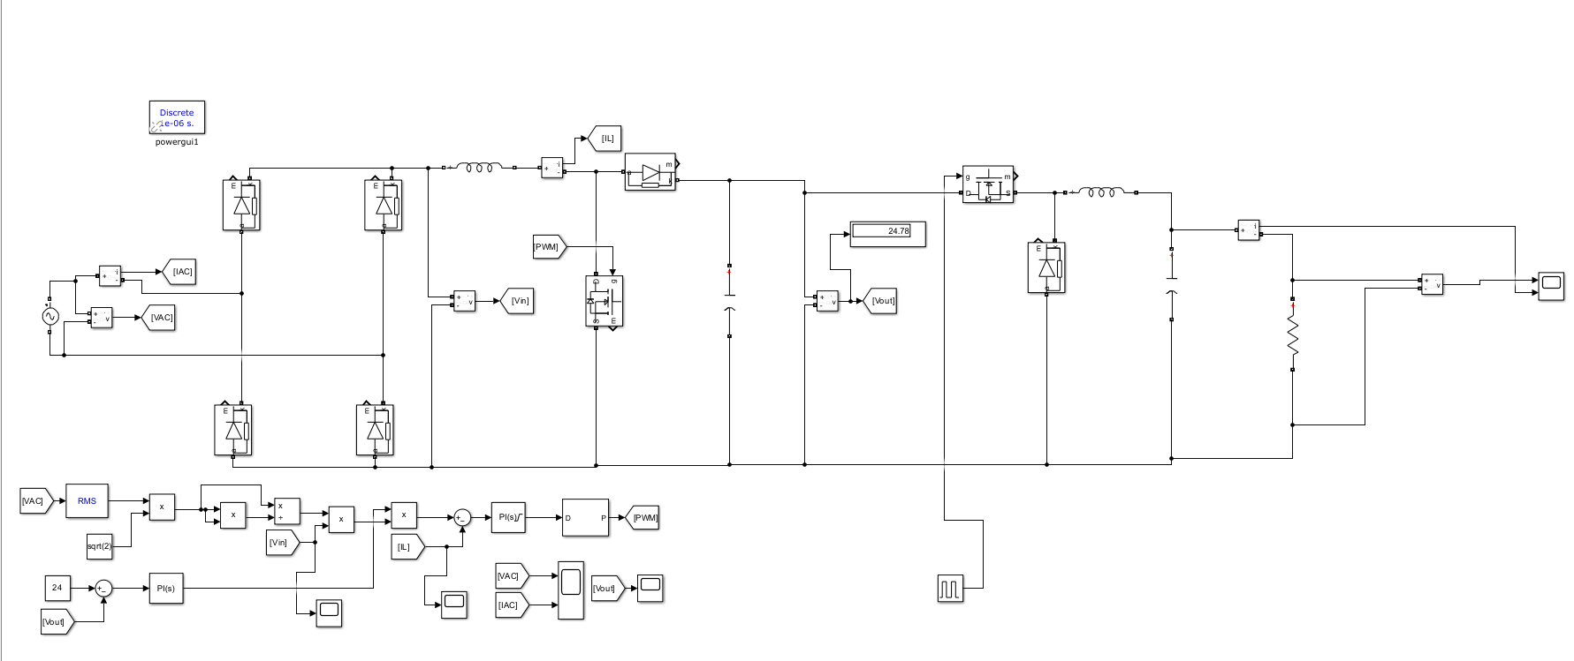
Simulation

Slide 8
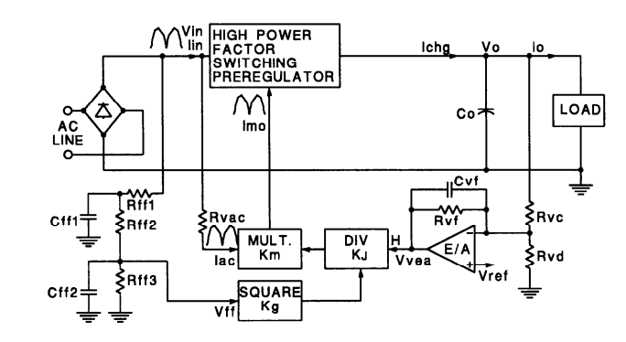
PFC LOGIC

Slide 9
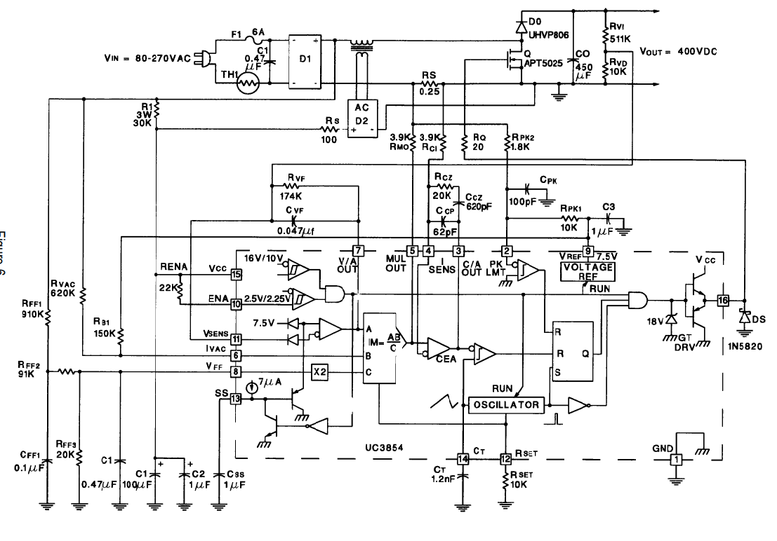
PFC CIRCUIT DIAGRAM

Slide 10

Battery Specifications
Charging C rate: 0.25
Charging current :1.75 A

Slide 11
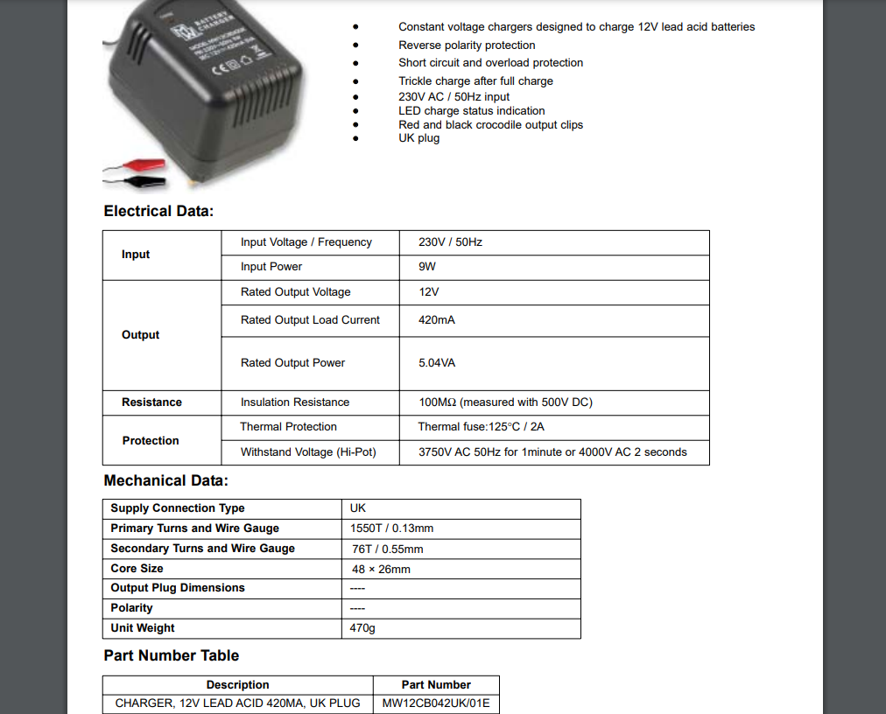
COMPARISON WITH EXISTING CHARGERS
CC mode – 1.5A
Constant frequency controlling method
Almost 1.5 times faster than conventional ones in CC mode

Slide 12
Literature Survey
Authors | Title of paper | Inference
Harish Karneddi,Deepak Ronanki,Ricardo Lizana Fuentes | Technological Overview of Onboard Chargers for Electrified Automotive Transportation | The paper highlights the evolution of onboard chargers as a vital component in accelerating the adoption of electric vehicles. By systematically reviewing PFC and battery interface topologies. Future advancements in nonlinear control methods and wide-bandgap devices (like SiC) are crucial for further enhancing OBC performance.
Ricardo Lizana Fuentes,Lalit Kumar Sahu,Akhilesh Kumar Tiwari | Single Phase Isolated Onboard Charger for Electric Vehicle | This paper highlights a compact, efficient, and reliable OBC design that ensures high power quality and stable charging under varying grid conditions. It emphasizes the importance of combining advanced PFC techniques and ZVS-enabled DC-DC conversion for improved efficiency and reduced losses. The study's results validate the suitability of the proposed OBC for practical EV applications.

Slide 13
Authors | Title of paper | Inference
Hongyan Liu | THE DESIGN OF INTELLIGENT CHARGER OF ELECTRIC VEHICLE UNDER THE CONTROL OF MICROCONTROLLERS | The paper presents an intelligent EV charger based on the STC12C5204AD microcontroller, which dynamically adjusts charging voltage and current to protect the battery and extend its life. It employs a three-stage charging method (constant current, constant voltage, and floating charge) to optimize charging efficiency and prevent overcharging. Compared to general chargers and other MCUs (8xC752 and C504), it demonstrates superior performance in maintaining specific energy density and delaying battery aging. The design integrates temperature monitoring and pulse charging, ensuring safety, efficiency, and balanced battery charging.

Slide 14


Sensors Ideolgy
Current sensor (ACS712)
Voltage sensor (INA219)
This code senses current and voltage from the battery and gives input to the MCU which sends a PWM signal to the gate MOSFET.

Slide 15
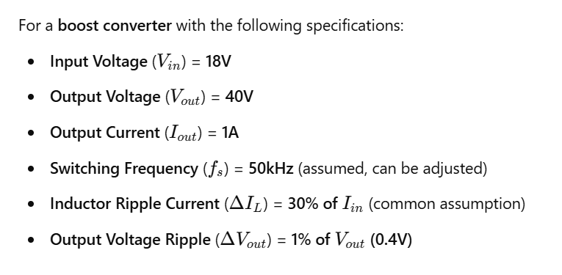
Boost Converter Design

Slide 16


Slide 17


Slide 18


Slide 19


Slide 20

Buck Converter Design

Slide 21


Slide 22


Slide 23
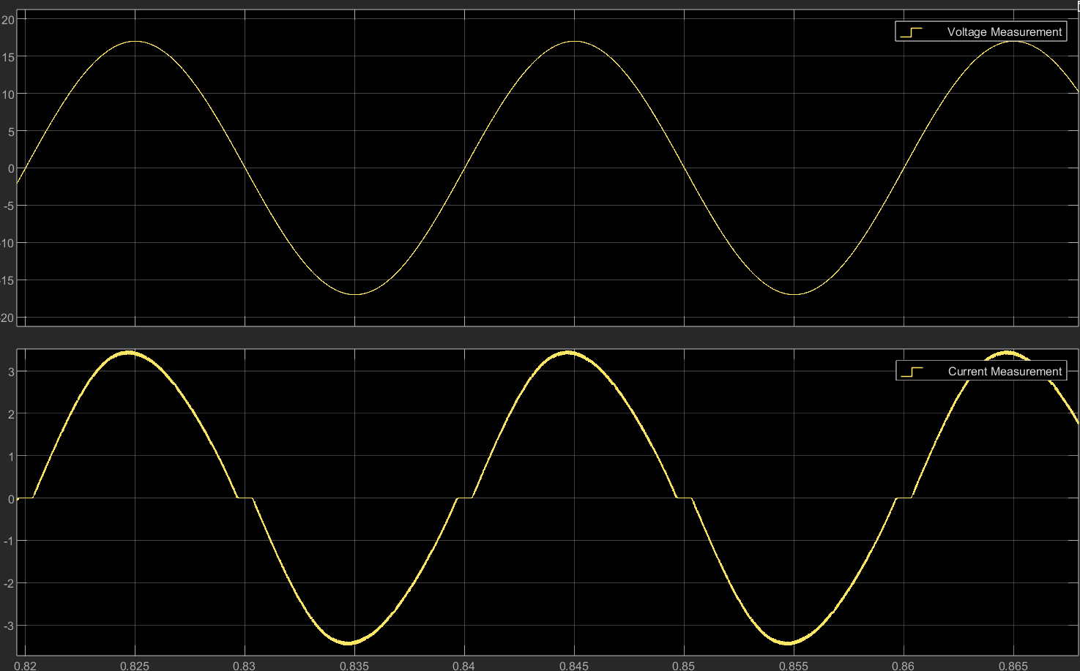
Input Waveforms

Slide 24
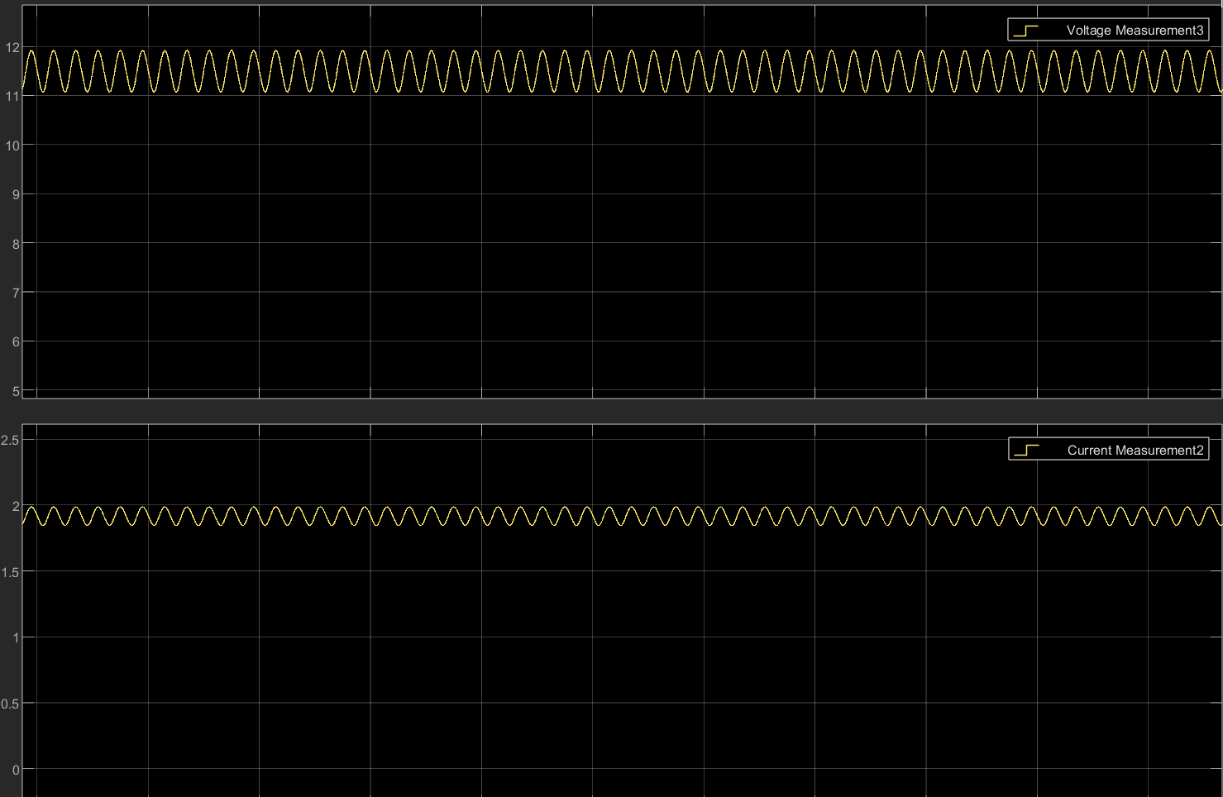
Output Waveforms

Slide 25
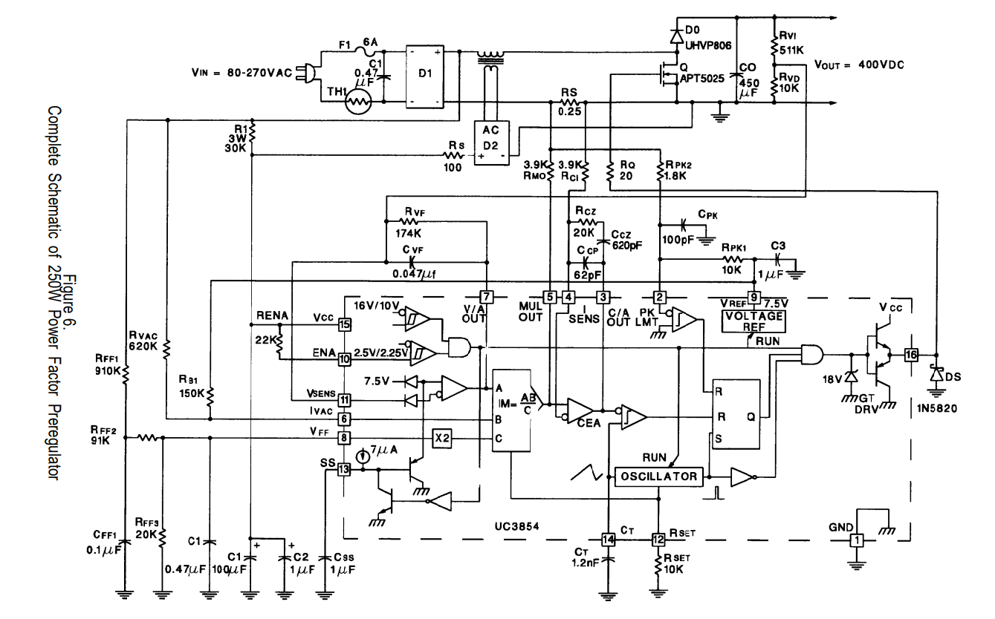
Power Factor Correction circuit

Slide 26
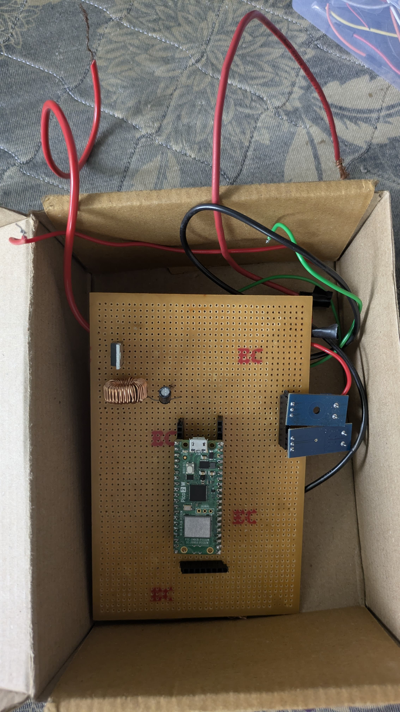
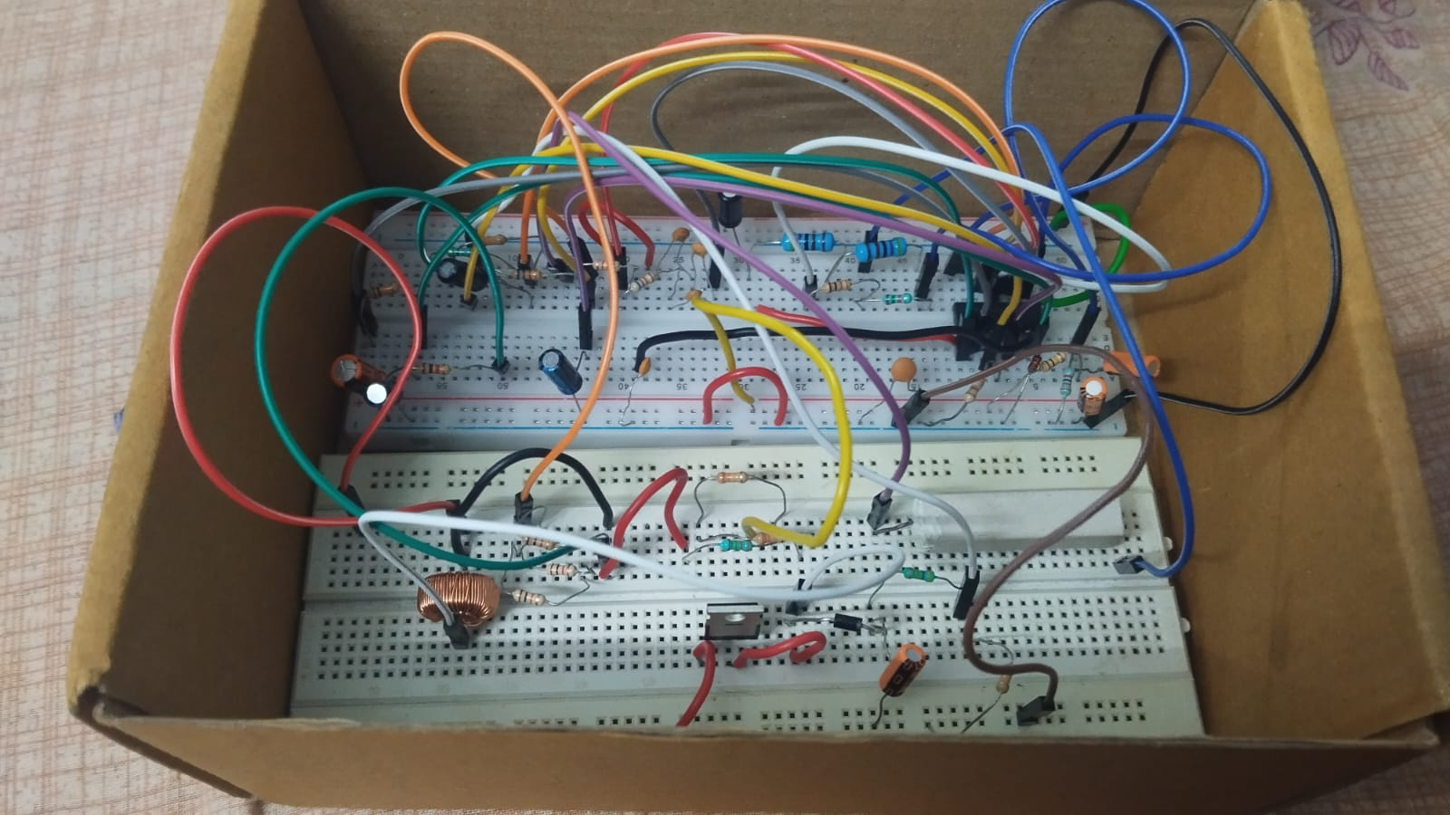
Hardware Implementation

